Slide 1

IAM Complicated
Why you need to know about IAM
Ron Parker | @scmunk
Notes:
My name is Ron Parker. I work for a Fortune 250ish Insurance Company. Been in Risk and Security for over 10 years with that being backed up by lots of development, IT Architecture and overall Security Architecture
Learn about IAM from beginning to end
This will be an overview and not rocket science
IAM is foundational for what we do
All of that in less than an hour
->So I was thinking one day - Burrito

Slide 2
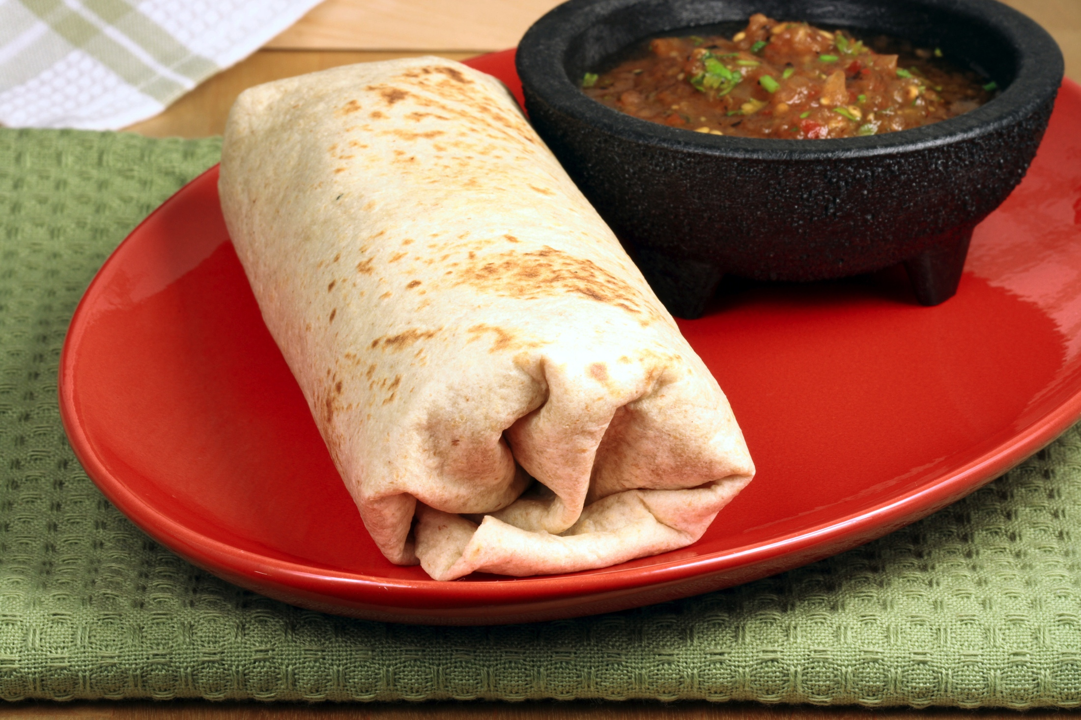

Notes:
Some time you sit and think, what is for supper, – Boy I sure would like to have some burritos
I can cook, I’ll just throw some together
->First tithing I need to do is grab some stuff and thangs

Slide 3

Notes:
So you go gather up all the burrito goods, you know all the stuff you have in your refrig
-> once you get everything together you need to go grab some cooking stuff, utensils, pots

Slide 4
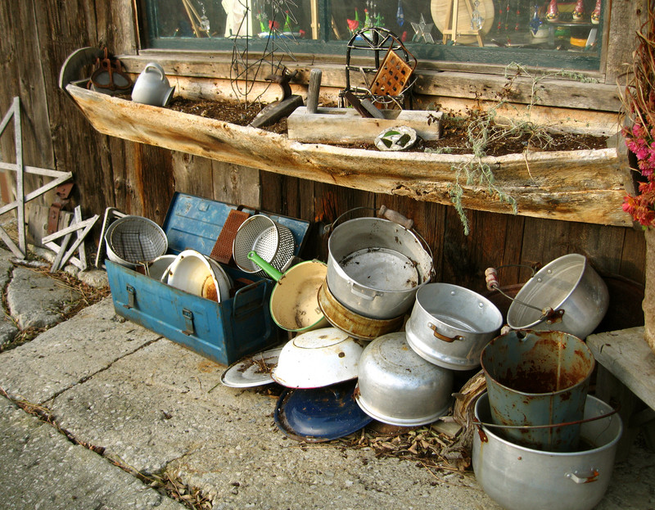
Notes:
You go grab all the pots and pans, your cooking tools, you have around
Burritos arent that big of a deal
You have all the stuff laid out and start building your burrito, ingredients by ingredient
You add everything smaller than a baby giraffe, you use both hands, maybe a foot
->Then you end up here

Slide 5
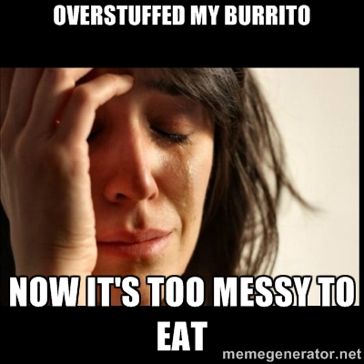
Notes:
Now things begin to really go wrong
->So maybe you try it again, you have plenty of stuff

Slide 6
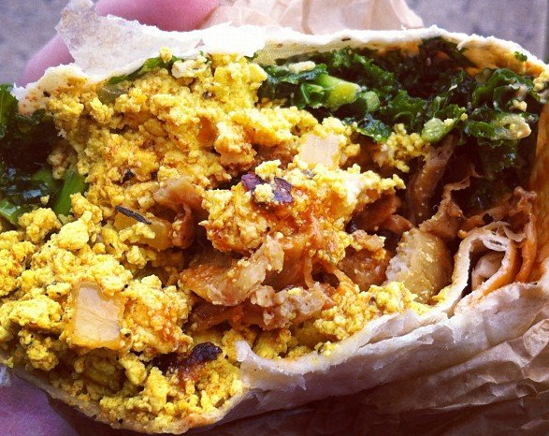
Notes:
And the second one you made didn’t turn out much better
Now, you are finished eating all you can stand
->So it is just time to clean up

Slide 7
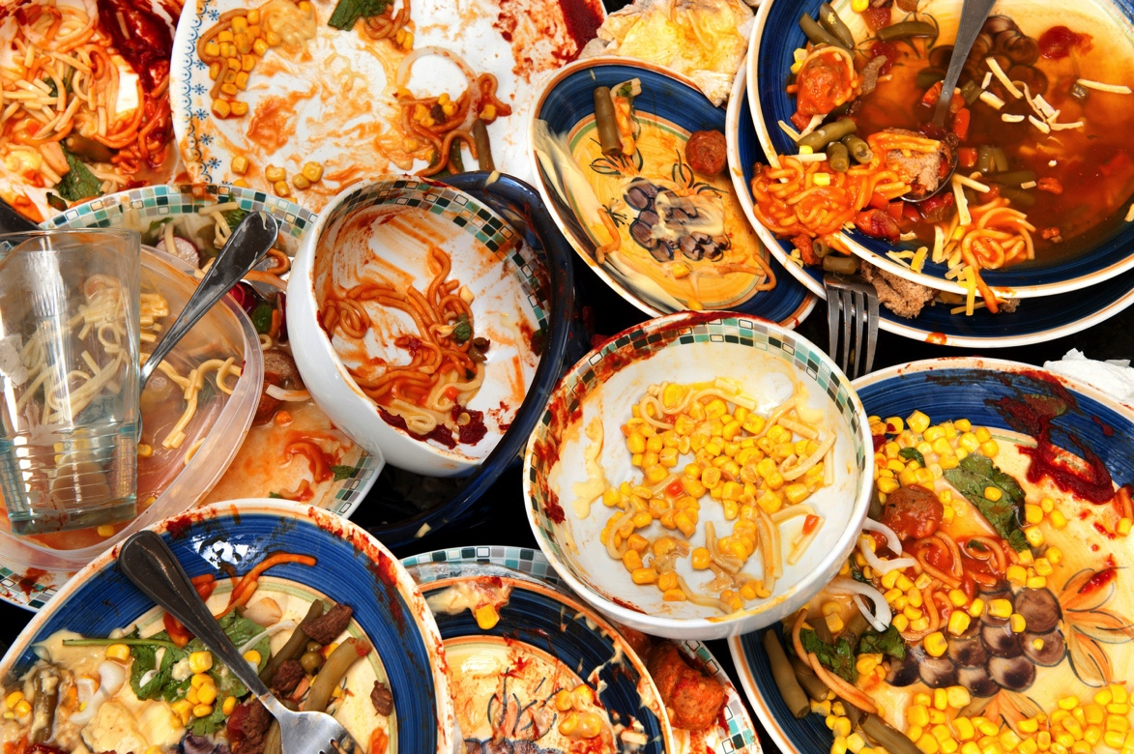
Notes:
Problem is you don’t make burritos all the time
You may not have the correct tools
You used the same spoon to get the bean and the sour cream
→You are left with a mess

Slide 8
What went wrong?

Slide 9
Bad tools and ingredients.
No burrito processes.
Bad burrito skills.*
But you have had good burritos…
*skills = skillz or 5k1ll5 for all you 1337
Notes:
You made a mess because of a lack of burrito process, no burrito skillz, not the correct ingredients, using the incorrect tools
->Think back

Slide 10
Bad tools and ingredients.
No burrito processes.
Bad burrito skills.*
But you have had good burritos…
Where did you have a good burrito?
Notes:
->

Slide 11
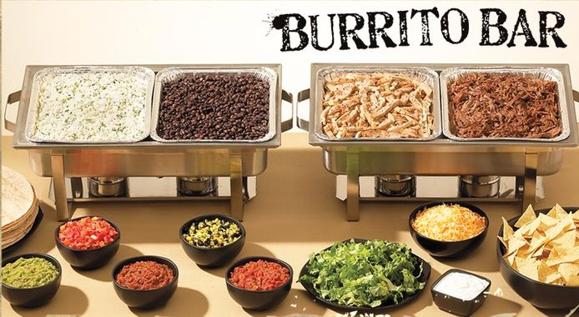
Welcome to Joe’s!
‘
J
o
e
s
Burrito Barn
Notes:
WELCOME TO JOES!
It was Joe’s Burrito Barn
They had it all together, look at the layout, the people, the steamers, the grill
-> they can make a good burrito

Slide 12
Notes:
Mmm burritos
-> BUT

Slide 13
What do burritos have to do with
Identity and Access
Management?
Notes:
You are 38 slides in and wondering where are we going here?
->

Slide 14
What do burritos have to do with
Identity and Access
Management?
Making a burrito consistently and efficiently requires a lot of processes, ingredients, and tools

Slide 15
IAM has lots of parts, needs lots of tools, requires lots of process plus people with skills.
Notes:
-> ya know

Slide 16
IAM complicated
Just like Burritos
Notes:
Complicated or Complected or Complex all has to do with many parts all braided together
This is the point where you say “oh, I see!”
Lots of pieces all tied together
That is what is in common
-→So, what about Joes?

Slide 17

There are a lot of reasons Joe’s can build a better burrito.
Menu
Specialized stations
Prepared ingredients
Standards
Correct tools
Skilled people
Processes to tie it altogether
Notes:
Yes, this is Bob the Burrito – He did have a cousin at MS
A menu is like choosing a repeatable workflow – faster when you have it your way?
Specialized stations are in order, fast and efficient
Correct tools are fast and efficient, incorrect tools can be dangerous

Slide 18
Good People. Good Process. Good Technology.
Process
HR
People
Menu
Recipes
Trained People
Technology
Enough People
Stations
Grills
Steamers
Warmers
Notes:
It boils down to something simple and easy to understand
PPT
This applies across burritos and security
->This especially applies to IAM

Slide 19
The World of IAM
Intelligence
Access Management
Access Control
PAM
Notes:
This is one picture of IAM
This has its root in the Gartner model

Slide 20
The World of IAM
Intelligence
Ultimate runtime goal
Gather and Analyze
Access Management
Access Control
PAM
All the setup
Privileged Access Mgmt
Notes:
You may have slightly different names but
Access Management – administration, operations, setup
Access Control - runtime
PAM -
Intelligence – wraps around everything, this intelligence should actually be around everything security realted
-> so why do we need IAM

Slide 21




Why does IAM matter?
IAM sets things into place so we can do security – so we can protect what is important.
People
Brand
Thangs and Stuff
It drives the policy for firewalls, ACLs, segmented networks, and accounts.
Information
Notes:
If you are in security you need to know about IAM.
If you arent connected with IAM that means we arent being efficient, we may not be doing what is best for the company.
If we don’t have IAM then we have to look at how those processes work in our area. (Maybe too small)
-> lets talk about all the parts

Slide 22
Access Management
Notes:
So lets talk about AM – how to set up security.

Slide 23
Access Management
Security Model
Entitlements
Identities
Provisioning
Notes:
There are actually more pieces including governance and even some risk

Slide 24







Access Management: Selecting a Model
Brand
Importance of
People
Brand
Physical assets
Data
Privacy
Process
Alarms
HR/Payroll
POS
Notes:
What is important and how important is it
A model helps us put the right controls in place
You may also use several models

Slide 25
Access Management: Goal of Models
Efficiently apply security
Get the right security controls in the right places
These models try to control the Confidentiality, Integrity, and Availability of the resource.
Notes:
What is CIA
Bell-LaPadula – Confidentiality
->So what models are there?

Slide 26
Access Management: Common Security Models
Direct assignment, discretionary (DAC)
Assigned to user and resource
No model model
Mandatory Access Control (MAC)
Labels and attributes
Low level
Security Enhanced Linux (SELinux)
Roles Based Access Control (RBAC)
Permissions given to roles
People/entities are assigned to roles
LDAP

Slide 27

Access Management: Security Models
Attribute Based Access Control (ABAC)
Rules or polices based on attributes
Many others named only in the depths of Government basements
Notes:
Bell-LaPadula - Confidentiality
Clark Wilson
-> So lets look at what you would do at Joe’s

Slide 28
Access Management: Rights and Resources at Joe’s
Resource
User
Operate
Alarms
Rick
Schedule and Pay
Operate
HR/Payroll
Operate
Maggie
Operate
POS
Carl
Notes:
Almost all models start with
1 – determine the resources (things) you are trying to protect (inventory)
2 – determine the actors who will be involved (humans or systems)
So we have a couple of people doing a couple of things
->This is just with three people

Slide 29
Access Management: Adding more people
Resource
User
Operate
Alarms
Rick
Schedule and Pay
Eugene
Operate
HR/Payroll
Operate
Maggie
Operate
POS
Carl
Notes:
This is with 4 people, if we had a full staff this would be a rats nest
This is an old problem
->So lets look at the pieces

Slide 30
Access Management: Looking at Entitlements
Managers
Crew
Operate the alarm
Schedule
Pay people
Operate the POS
Operate the POS
Entitlements are the authorizations, permissions, and rights that let you do things
They are the basis for Access Control
Notes:
What can you do?
Permissions, Rights, What you are entitled to do
If you don’t understand your entitlements you will not get access control correct
->So how do we organize these into a model?

Slide 31
Access Management: Roles and RBAC (Roughly Right)
Resource
Role
User
Operate
Alarms
Manager
Rick
Schedule and Pay
Operate
HR/Payroll
Crew
Maggie
Operate
POS
Carl
Notes:
RBAC is very common because t helps gather entitlements into buckets
We had Managers and Crew – they could do stuff
The roles are assigned the rights not necessarily the individuals directly
Then the people are associated with the Roles
->What happens if we need to add people now/
RBAC is actually hard to implement
Most place implement “Roughly Right”

Slide 32
Access Management: Adding more people with roles
Resource
Role
User
Operate
Alarms
Manager
Rick
Schedule and Pay
Eugene
Operate
HR/Payroll
Crew
Maggie
Operate
POS
Carl
Notes:
This is the “value add for RBAC”
Easier to maintain on the left and on the right
Easier to audit
Fewer places for mistakes
When you do one-offs you can make mistakes either way
->There is actually a lot going on here

Slide 33
Access Administration: What is really happening
Resource
Role
User
Manager
Alarms
Negan
Relate the group to the resource
Add to group
(role)
Set permissions for the group
Create group
Determine and create the role
User Identification
All of this has to happen to enable Access Control
Notes:
So entitlements are one side of the coin
Identities are the other
A lot has to happen to connect it all together
MOVE FROM RIGHT TO LEFT
->Identities are the other side of the coin

Slide 34
Access Administration: Users, Identities, Accounts
User
Identity
Account
Rick@Joes.com
Rick27@SFDC.com
RickG@WorkDay.com
Rick
Eugene@Joes.com
Eporter@SFDC.com
Eugene21@WorkDay.com
Eugene
Maggie@Joes.com
Maggie
Carl@Joes.com
Carl
Notes:
Other side of the coin (Entitlements)
Entity or System – Each with A digital identity – primary association
From a company stand point you want each person to have as few as possible
It is what you use to login it is primary
Accounts are in the secondary systems

Slide 35
Access Administration: Identities and Attributes
Identity Attributes
Account Attributes
Name
Employee ID
Department
E-mail
Passwords
Certificates
Employee ID
System specific info
Account limits
Preferences
Defaults
One collection of these for efficiency – important for centralized security
You may have one set of these per system – some of these may not be in your control
Notes:
A digital identity has information attached to it
Name, department, credentials
You normally gather all the identity info an place it in one location – directory or repository
→Accounts are very similar except they are more specific to a system or application

Slide 36
Access Administration: Identities and Attributes
Identity Attributes
Account Attributes
Name
Employee ID
Department
E-mail
Passwords
Certificates
Employee ID
System specific info
Account limits
Preferences
Defaults
Sales Force
Other Directories
Local Apps
WorkDay
One collection of these for efficiency – important for centralized security
You may have one set of these per system – some of these may not be in your control
Notes:
You may have a record in your corporate directory and multiple records
->As you gather together you need a good repository

Slide 37
Access Administration: Directories
LDAP
Hierarchical
Very fast reads
Standard layout
Standard Protocol
Can be used for identities
Can be used for entitlements
Can be SQL-based
Example Systems
OpenLDAP
Active Directory
OpenDJ
RadiantOne
IBM Directory
Notes:
Back in the 80’s the X.500 and Directory Access Protocol was invented by the telephone and communication companies
After several iterations we have Lightweight Access Directory Protocol – simplest option
Object based, indexed by path
Made for querying – Querying
This is the most common approach these days
Powershell, LDAPSearch, Jxplorer

Slide 38
Access Management: Directory Contents
Joes
People
Groups
Managers
Crew
Carl
Maggie
Rick
Eugene
dc=joes,dc=com
dc=Carl,ou=people,dc=joes,dc=com
dc=Maggie,ou=people,dc=joes,dc=com
dc=Rick,ou=people,dc=joes,dc=com
dc=Eugene,ou=people,dc=joes,dc=com
cn=groups,dc=joes,dc.com
ou=managers,cn=groups,dc=joes,dc.com
ou=crew,cn=groups,dc=joes,dc.com
LDAP directories can house both identities and entitlement information
Notes:
Can easily keep identities or accounts along with high level entitlement
Everything is uniquely identified and index in such a way that it is very fast to query
Paths are like file path except they point to objects
->So now that we have all of this how do we work with it?

Slide 39
Access Management: Provisioning
Provisioning is the act of creating all the necessary logical and physical items necessary to for a new identity or modifying an existing identity to make it functional in the environment
Phone
Role
E-Mail
Cloud Accounts
How many mistakes could be made if this is all manual?
Key Card
Office Space
Network Access
Local Accounts
Mercedes S-600
Notes:
We have identities, accounts, attributes but there is more
You also have to be given e-mail setups, office space, cell phones, key cards
All of this giving and assigning is called Provisioning
The issue is how do we do this efficiently?

Slide 40
Access Management: Workflows
Joe’s Menu
Service Menu
Big Burrito
Small Burrito
The Vegan
The Glenn
New Hire
Add Crew Role
Add Manager
Transfer
Terminate
Notes:
Lets look back to Joe’s
They use workflows every day – look at the menu
It is a fast way to get a repeatable burrito
The people know how to deploy it – all you need to do is put in a request
Vegan – take out good put in something green
-> in IAM this is formalized

Slide 41
Access Management: Provisioning Workflows
Each set of steps can be automated
Workflows can be audited and controlled
Reduces mistakes
Better than a checklist
Many systems use standards such as BPMN (Business Process Model and Notation
Notes:
Once we get this understood and digitized
We can Automate it
Now we can take requests and make this security model work with little intervention or tribal memory
Loggable, It is auditable, Extensible
Identities, accounts, physical things – can cover it all
->Summary

Slide 42









Access Management Lifecycle
Cloud Accounts
Active Directory
System Accounts
Physical Items
Security Modeling
Person or System
IAM System
Setup
Provisioning
Requests
Attestation
Termination
Notes:
This is Access Management
Two pieces we havent spoke a lot about because it wouldn’t make sense until now
Attestation is a part of governance –
Termination is also important to be automated especially with CSP

Slide 43
Access Control

Slide 44
The World of IAM
Intelligence
Access Management
Access Control
PAM
Notes:
Now lets move over to Access Control – the more runtime of security

Slide 45
Access Control
Authentication
Multi-factor Authentication
Single Sign On/Reduced Sign On
Federation
Authorization
Entitlements
Federation (again)
Notes:
Two main areas we will cover
Who are you and what can you do

Slide 46
Authentication
One of the many definitions:
Authentication is the process of confirming who you (Entity) claim to be (Identification) by matching provided credentials to those expected. This information is tied to a Digital Identity.
Credentials
Validate
Authentication Token
Entity
Authentication System
Directory LDAP
Authentication
Notes:
Security credentials are a piece of evidence that a communicating party possesses
Credentials – id/pwd, certificate,
This can be at a network login
LDAP keeps the ID and the credentials – verifies at runtime
Walk Through
-> this is basic sign on but there are variants

Slide 47

Authentication: Single Sign On/Reduced Sign On
Directory LDAP
Backend System
Appropriate Proof of Authentication
Authenticated
Session Token
Entity
Authentication System
Backend System
Most SSO systems use a session token. A cookie, or HTTP header.
The Authentication System may send a session token to the backend system or even an ID/Password.
Backend System
Notes:
Reduced sign on is where the backend systems may use the same directory
SSO is where there is more of a session based mechanism
You may have to log in more than once but use same id
Active Directory is a huge SSO system the way it works – “free”
-> As you move from SSO to more cloud related systems we began to see a change

Slide 48
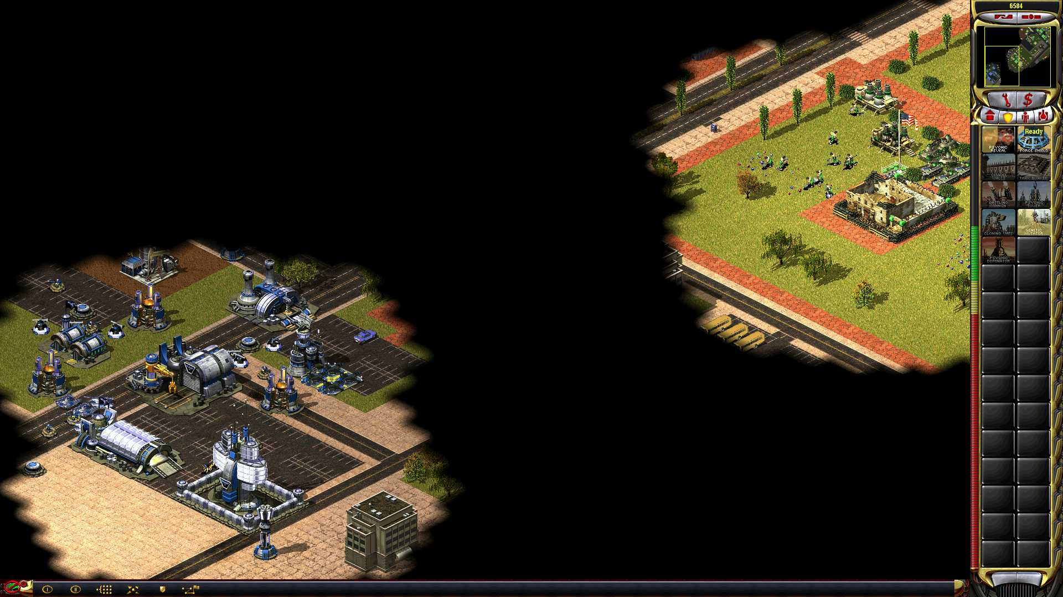
Notes:
What is this
Fog of War - Nope
Fog of Federation
Federation is where you cant see everything, you have to trust what you see and work with that

Slide 49

Authentication: Federation
Security/Domain Boundary
Established Trust
Security/Domain Boundary
Authentication Identity Provider
Entity
Token Provider
Authentication System
Service Provider
Token
Notes:
As we began to work with things outside our security boundaries we had to work out a way for security to work
How do we connect two security system with completely different policies
Federation lets us set up a trust between the domains then pass security info back and forth
The important point is that the entity only authenticates once then the second domain trusts the authentication
This is done with Tokens (SAML, Oauth,OpenIDConnect)
Federation can be a little of authentication and a little authorization

Slide 50
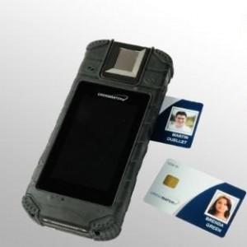

Authentication: Assurance
Do I really know who you are saying you are is really who you say you are?
Social Login
I am who I am.
OTP:946422
abc123
Notes:
No matter how you are authenticating you have to understand assurance before you move forward
You have to understand the level of authN NIST 800-63
Some things require a low end, some things require high end
If you don’t know that will be trouble
Most Windows shop use network authentication and active directory

Slide 51
Authorization
Authorization is determining when and what an entity is entitled to do. It is the other half of the access policy.
Group Membership
The way authorization decisions are made and applied at runtime are greatly determined by the security model.
Some models are purely policy (code).
Direct Assignment
Attribute
Assertion
Notes:
Once you know who you can figure out what they can do

Slide 52
Access Control: Logical to Runtime
Logical/Management
Resource
Role
User
Manager
Alarms
Negan
Deployed/Runtime
Resource
Group
Identity
gManager
Negan@Joes.com
Alarm Application
Notes:
This can get very complex
Pieces can be placed close together or far apart
ACL, Policies, AWS Uses Policy Strictly

Slide 53
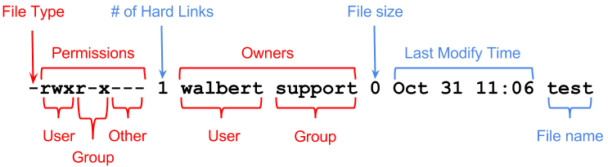
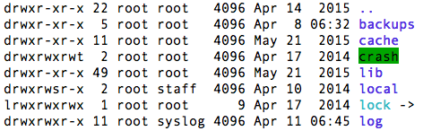
Access Control: Linux permission examples
Notes:
Linux is more local
It is User/Group/Everyone else

Slide 54
Authorization: AWS Policy
{
"Version":"2012-10-17",
"Statement":[
{
"Sid":"AddPerm",
"Effect":"Allow",
"Principal": "*",
"Action":["s3:GetObject"],
"Resource":["arn:aws:s3:::joesbucket/*"]
}
]
}
Notes:
Allows everyone to getobjects from the example bucket

Slide 55
Authorization: Entitlements - SAML
saml:AttributeStatement>
<saml:Attribute Name=”User_name">
<saml:AttributeValue xsi:type="xs:anyType">Rick Grimes</saml:AttributeValue>
</saml:Attribute>
<saml:Attribute Name=”user_email">
<saml:AttributeValue xsi:type="xs:anyType">rick@joes.com</saml:AttributeValue>
</saml:Attribute>
</saml:AttributeStatement>
Notes:
When we talked about SAML and entitlements this is what we were talking about
This can be passed to many systems these day
All this can be wrapped up with encryption

Slide 56
Authorization: Entitlements – Oauth 2 Token
{"access_token":"ACCESS_TOKEN",
"token_type":"bearer",
"expires_in":2592000,
"refresh_token":"REFRESH_TOKEN",
"scope":"read",
"uid":100101,
"info":{"name":”Rick Grimes",
"email":”Rick@joes.com"}
}

Slide 57
Authorization: Federation of Entitlements
Security/Domain Boundary
Established Trust
Security/Domain Boundary
IdP
Entitlement Provider
Entity
Token Provider
Authentication System
Service Provider
Token
Agreed Upon Assertions
Notes:
Federation can also be uses to send entitlement information
Often expressed as assertions
Because there is a trust
The target domain can trust and receive agreed upon Assertions
Domains can be internal – maybe between Linux and non-Linux
Linux and some vendor software

Slide 58
Authorization: Points of the Basic Model
Admin
Information
Entity
Decision
Enforcement
Resource
Notes:
If you have noticed we had components here and there
The different components had different purposes
Administration of Authorization Policy…
The Decision point is where the policy is execute – computed
Enforcement is the gate

Slide 59
Authorization: Policy Model with P’s
PAP
PIP
Entity
PDP
PEP
Resource
Notes:
True policy driven looks like this
Sometimes we just deal with logical
->So lets look how this plays out at

Slide 60

Disco Night
At
Joe’s Burrito Barn!
Notes:
It is Disco Burrito Night! They line up around the block to get in
It gets so busy they have had to hire a Bouncer to manage the guests

Slide 61

Authorization: All-in-one
PIP
Resource
PDP
PEP
Notes:
The person with the info is the person performing the enforcement
He has to know and do everything

Slide 62

Authorization: Ticket System/Certificates
->PIP
PDP
Resource
PEP
Notes:
Ticket are like bearer tokens – if you have them you can get in
His decision is “do you have a valid ticket?”
PIP - kinda

Slide 63

Authorization: Distributed model
PIP
PDP
Resource
PEP
Notes:
She says her name is Carol should I let her in?
Abraham calls up to the PDP who can see if Carol should be let in
You can spread out the functionality depending on the system
-> Lets look at more examples

Slide 64
Authorization: Active Directory/Kerberos
Domain Controller/Kerberos
Local Active Directory
PAP
PDP
PIP
Authenticates
Token
Accesses
Backend System
PEP (OS)
Person or System
Token

Slide 65
Authorization: Cloud SSO Model
Synchronizes
Local Active Directory
Cloud IdP
PIP
PAP
PDP
Authenticates
Token
Accesses
Backend System
PEP
Person or System
Token
Notes:
What do on premises vendors do

Slide 66
Access Control Runtime
Cloud SSO
SSO/RSO
Person or System
Authentication System
Authorization
- Entitlements
Token Services
Service Provider
Authentication
Authorization
Federation
Access
Notes:
This is the big picture for Authentication and authorization
Federation is optional

Slide 67
Privileged Access Management (PAM)
PAM is the approach, processes, and technology that helps control, audit, and reduce risk when administrative actions.
Identify administrative actions
Identify roles
Separate those from others
Monitor and audit actions
Temporary passwords
Technology
Automate to reduce the need
Segment operations
Networks
Consoles
Virtualization/VDI
VMWare Administrator
sudo
AWS Administrator
Active Directory Admin
Network Hardware Admin
Workday Administrator
SFDC Administrator
Notes:
What can administrators do in your environment?
The cloud and distributed environments are making this more complex
Linux/Unix has recognized this for a while
Windows is just now getting there
Build PAM into the management, runtime, and intelligence – architect PAM

Slide 68
Intelligence
Intelligence is the process of gathering data, analyzing data, and monitoring data in order to increase the level of security, and efficiency in the environment.
Log information
Monitor and alert
Analyze and correlate
Audit
Additions to privileged groups
Creation of admin accounts
Creation and quick deletion
Inactive accounts
Inactive groups
Correlate network to IAM
Determine normal actions
Notes:
There is a whole world of Intelligence in InfoSec – this is more about IAM
Log files, agents, network traffic, BroID, security Onion,

Slide 69
Summary
Access Management
Access Control
Establish standards
Understand your security approach
Resources, Entitlements, & Roles
Identities and Attributes
Use a single directory
Repeatable workflows – automate
Attestation/Monitoring
Establish standards
Centralize your authentication
Try to use Policy-based or Rules-based authorization when possible
Treat Federation as a foundational element
Tie in Intelligence from the beginning
PAM
Intelligence
Inventory privileged actions/roles
Put administrative controls in place
Put technical controls in place
Automate, monitor
Centralize your intelligence
Integrate intelligence from the beginning
Work closely with Network Security
Look at Open Source technologies

Slide 70

IAM Complicated
Why you need to know about IAM
Thanks!
Ron Parker
@scmunk
http://www.secretchipmunk.com
Notes:
http://www.canstockphoto.com

